Slide 1
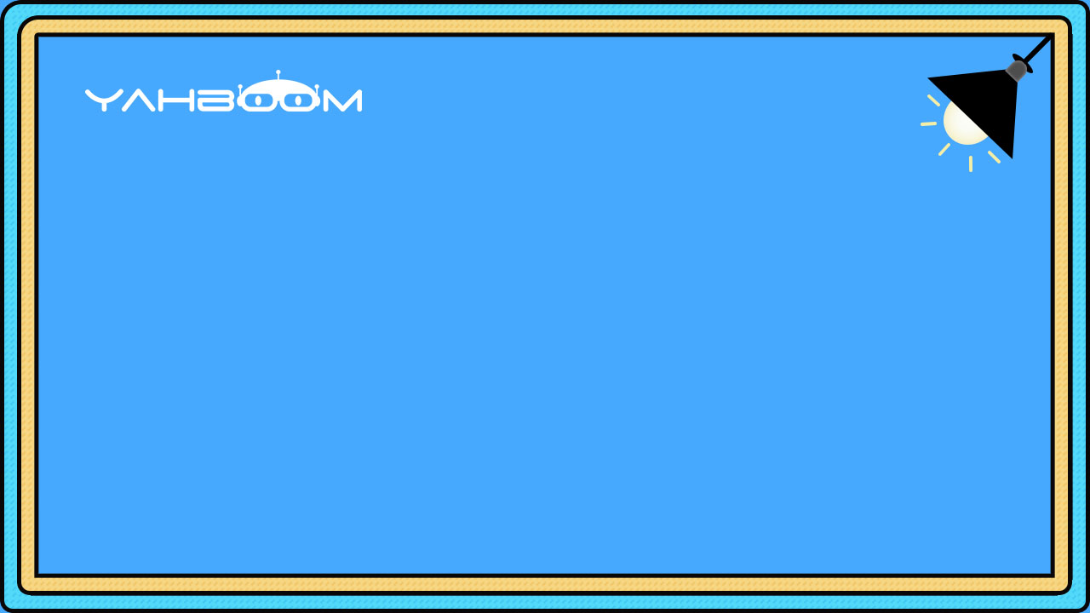

micro:bit programming tutorial
Lesson 1
micro:bit basic lesson 1“Horse race lamp”
Yahboom micro:bit tutorial

Slide 2
micro:bit programming tutorial
Part1
Part 2
Part3
Part 4
Part 5
Learning goals
Preparation
Search for blocks
Combine blocks
Have a try
Yahboom micro:bit tutorial

Slide 3
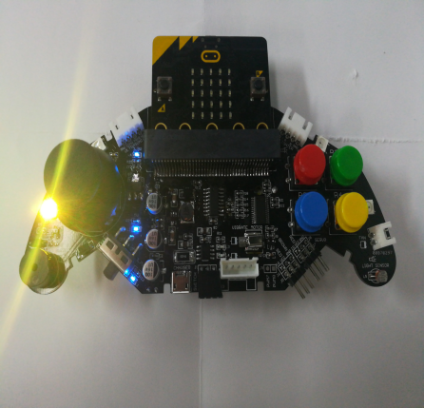
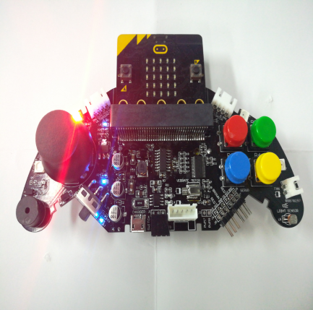
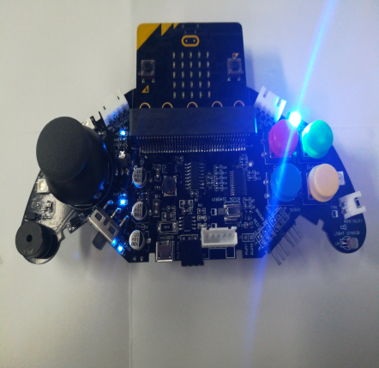
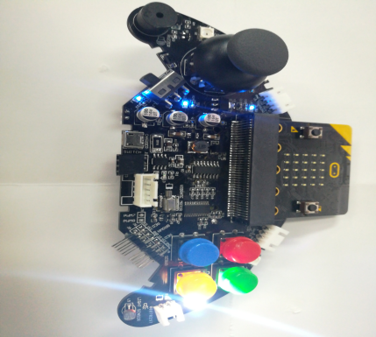
micro:bit programming tutorial
Part1
After you download the program, you can see colorful lights are lit from left to right on micro:bit Game Handle.This phenomenon we call the horse race lamp.
Yahboom micro:bit tutorial

Slide 4
micro:bit programming tutorial
Part2
Hardware：
● 1 X micro:bit Game Handle
● 1 X Micro USB Cable
Yahboom micro:bit tutorial

Slide 5
micro:bit programming tutorial
Two programming methods
Part2
1.Online: Connect Micro:bit to the computer via USB cable, and the computer will pop up a U disk and click the URL in the U disk to enter the programming interface.Enter this URL https://github.com/lzty634158/GHBit to get the package named GHBit.
2.offline：Open micro:bit offline programming software and add GHBit package.Click on "Advanced" and select "Add Package".Enter this URL https://github.com/lzty634158/GHBit to get the package named GHBit.
Note: If you already have a GHBit package, you don't need to add it repeatedly.
Yahboom micro:bit tutorial

Slide 6
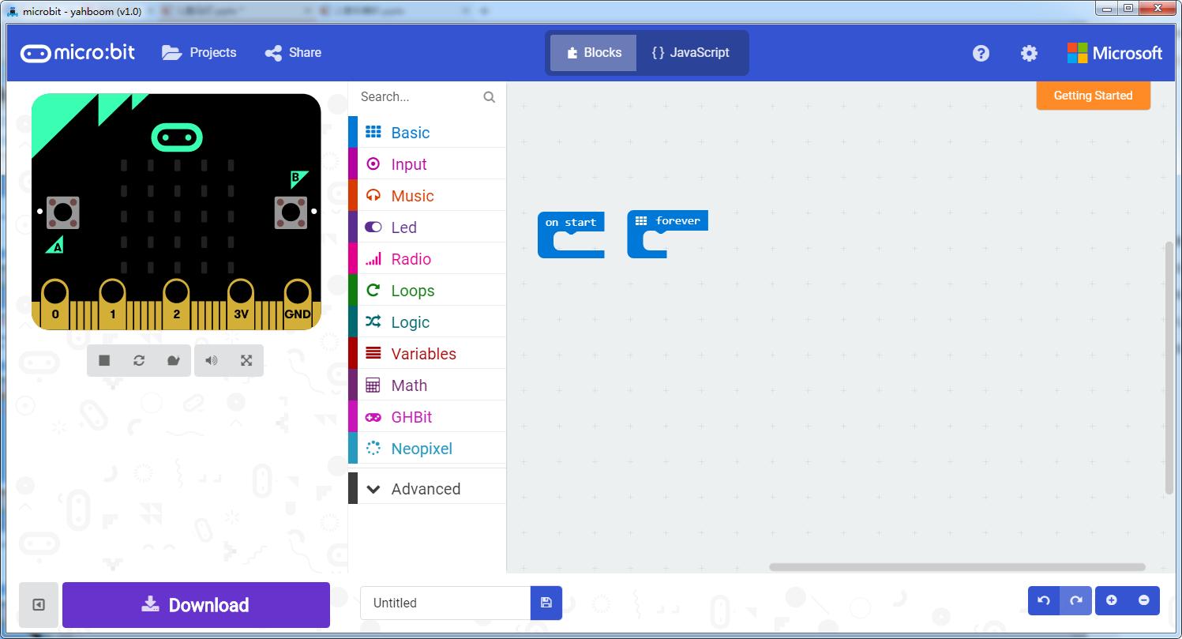
micro:bit programming tutorial
Programming interface
Part3
Yahboom micro:bit tutorial

Slide 7
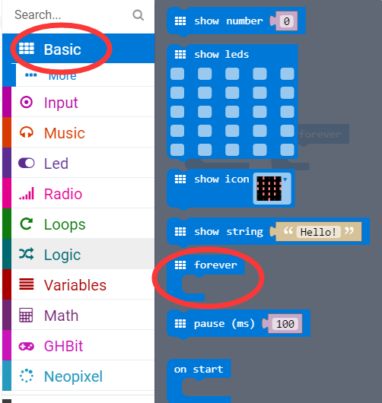
micro:bit programming tutorial
Part3
Start programming
The “forever” building block means that when the micro:bi Game Handle is turned on, the blocks in “forever” are repeatedly executed.
Yahboom micro:bit tutorial

Slide 8
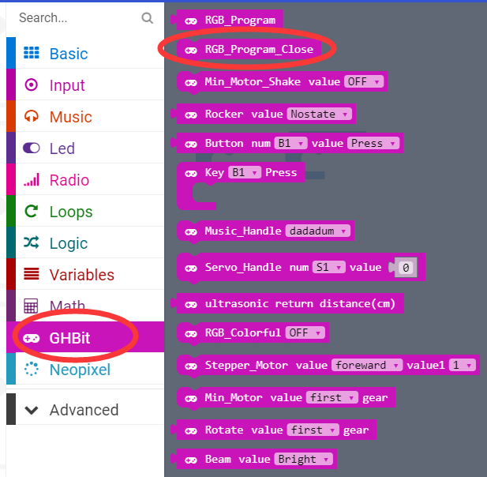
micro:bit programming tutorial
Part3
Turn off the colorful lights.
Note: Every time you complete an experiment on a colorful light, you need to use a program that turns off the colorful lights. Otherwise the colorful lights will remain on.
Yahboom micro:bit tutorial

Slide 9
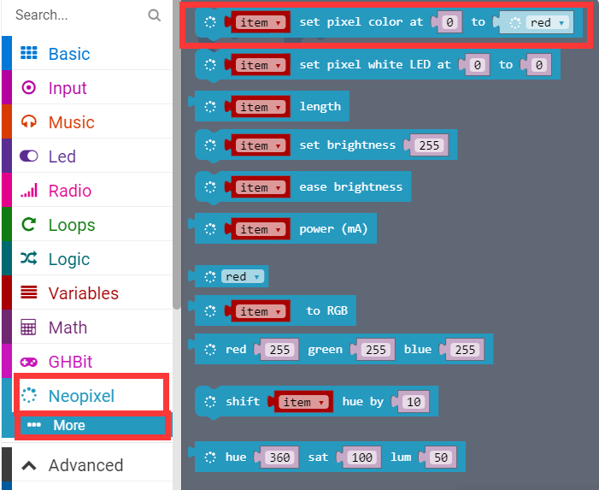
micro:bit programming tutorial
Part3
You can choose to control the color of one of the colorful lights and lights in the micro:bit Game Handle.
For example, the above picture is to control the third colorful light to be red.
Yahboom micro:bit tutorial

Slide 10
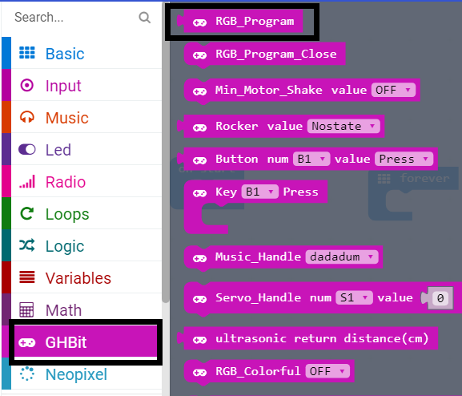
micro:bit programming tutorial
Part3
Use this building block when controlling the lights built into the micro:bit Game Handle.
Yahboom micro:bit tutorial

Slide 11
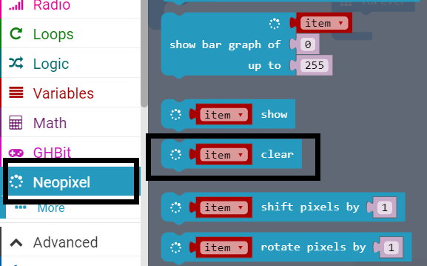
micro:bit programming tutorial
Part3
Use this block to make the colorful lights light up in the corresponding colors.
Yahboom micro:bit tutorial

Slide 12
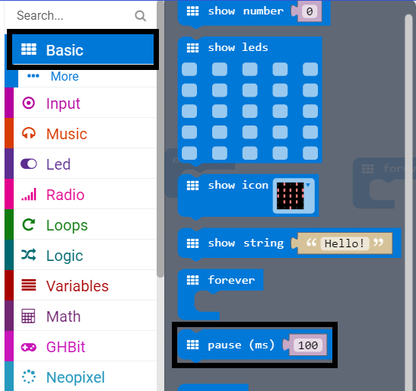
micro:bit programming tutorial
Part3
Pause for 100 milliseconds, in the program we change the value to 200 milliseconds.
Yahboom micro:bit tutorial

Slide 13
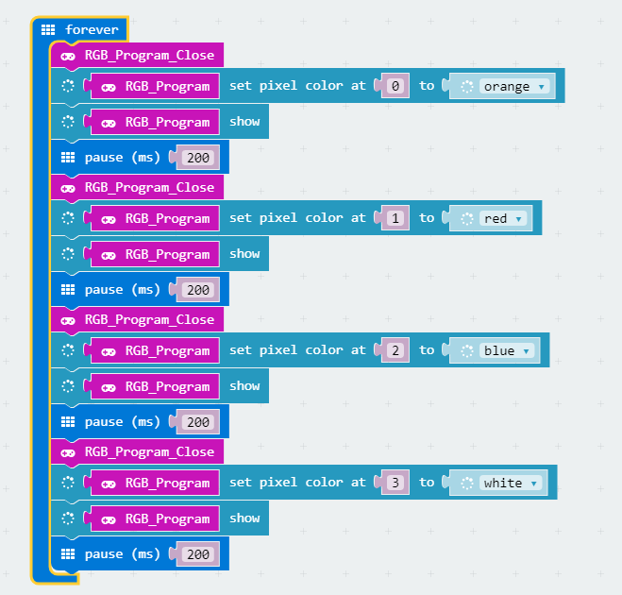
micro:bit programming tutorial
Part4
This is the complete building block for this course, let's download it to the micro:bit Game Handle.
Yahboom micro:bit tutorial

Slide 14
micro:bit programming tutorial
Part5
Do you learn the course today?
If you learn to do it, give yourself a top quack.
Now give you a homework assignment.
The marquee in the course is flashing clockwise. Please write a program that flashes counterclockwise.
Start your little brain. Try it.
Yahboom micro:bit tutorial

Slide 15
micro:bit programming tutorial
micro:bit
Thanks for watching！
Yahboom
Yahboom micro:bit tutorial

